Slide 1
Credit Card Customer Analysis
Presented by Team 2
Yulong Gong, Muyan Xie, Yangyang Zhou, Yichi Zhang

Slide 2




Team Member
Your great subtitle in this line
01
02
03
04
Yulong Gong
Muyan Xie
Yangyang Zhou
Yichi Zhang

Slide 3
Outline
4
Card type
1
2
3
5
6
Business Problem
Dataset
EDA
Results &
Recommendation
Q&A
4
Churn/ no churn

Slide 4
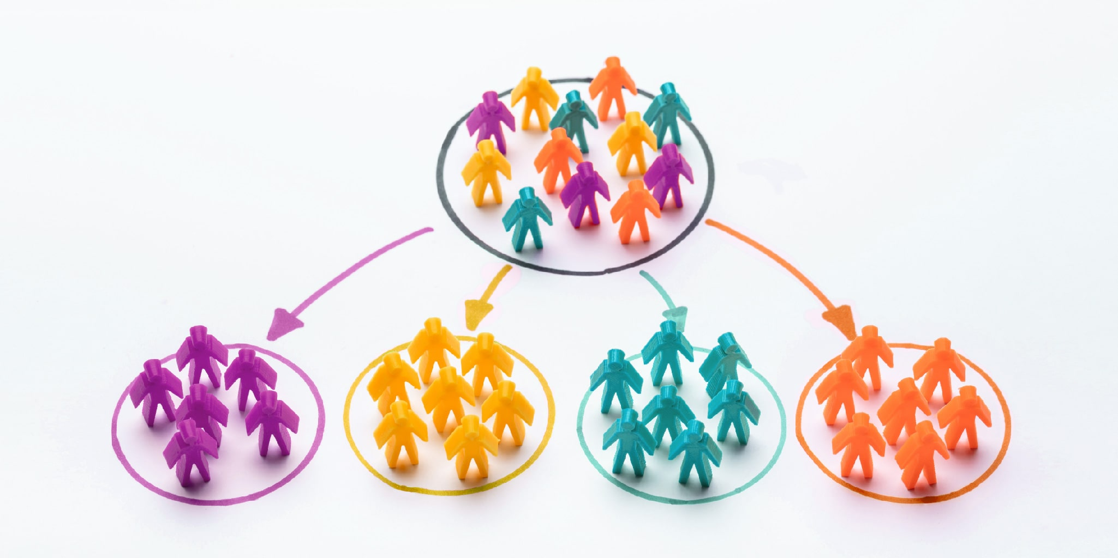

Business Problem
Help business entities identify natural customer clusters to help them evaluate products design.
Help business entities understand customer behavior patterns based on the artificial cluster label.

Slide 5
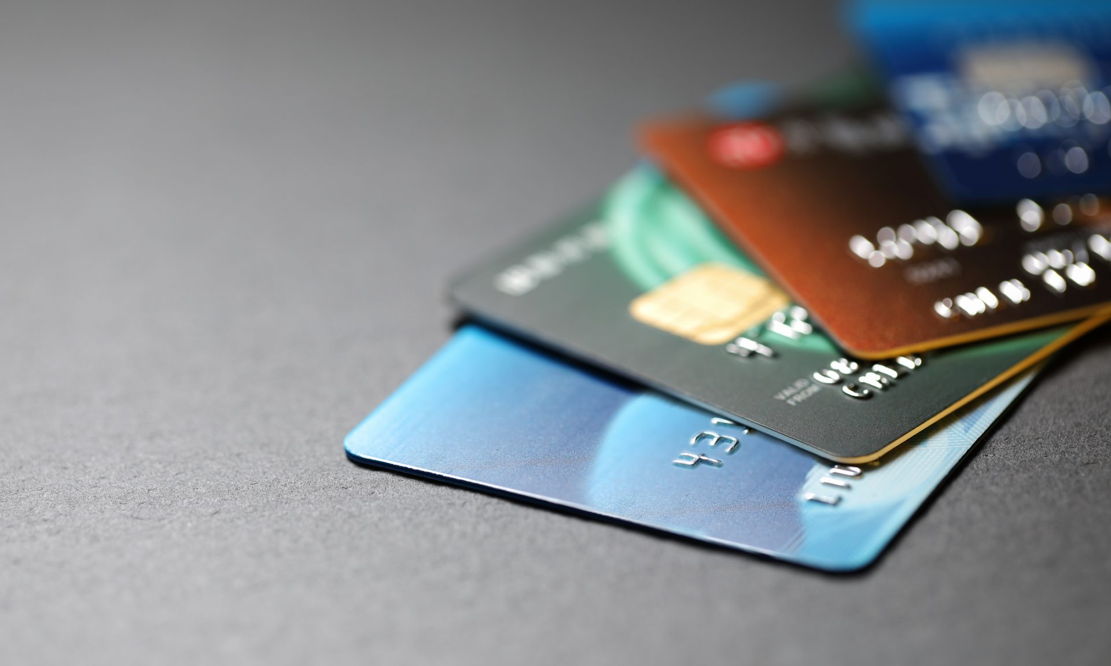
Dataset
Kaggle: https://www.kaggle.com/sakshigoyal7/credit-card-customers
10,127 observations, 21 variables, 1 index, 6 categorical, 14 numerical
Only 16.07% of customers who have churned
There is no null value

Slide 6
EDA
47 % Male/ 53%Female
Distribution of card types
93%
Blue
84% No churn/ 16% churn
5.5%
Silver
1.3%
Gold
0.2%
Platinum

Slide 7
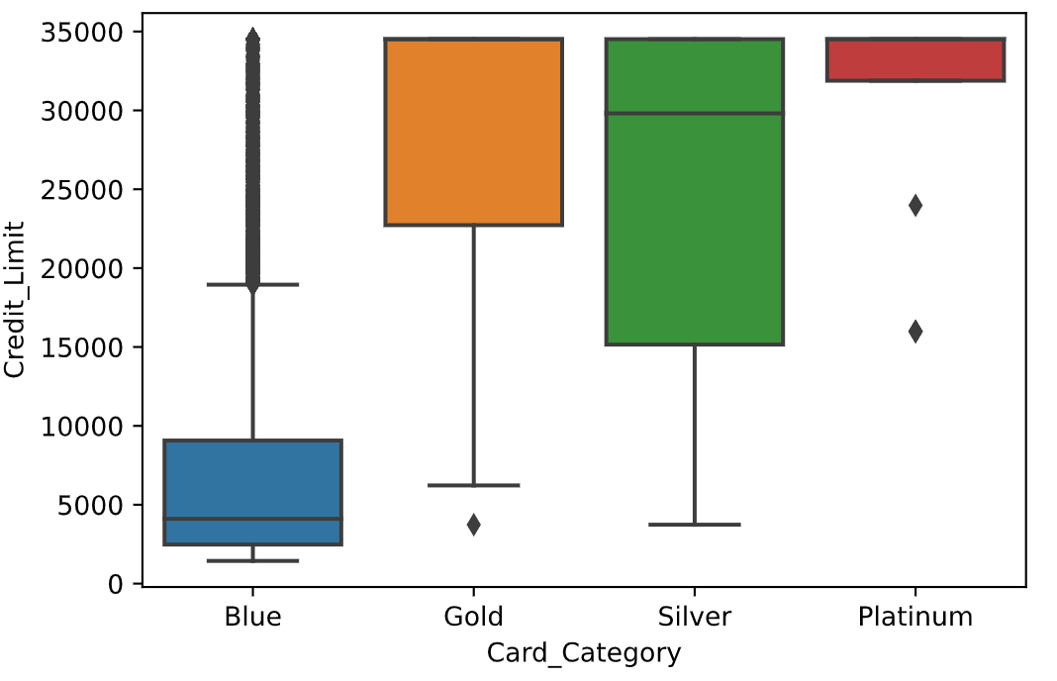
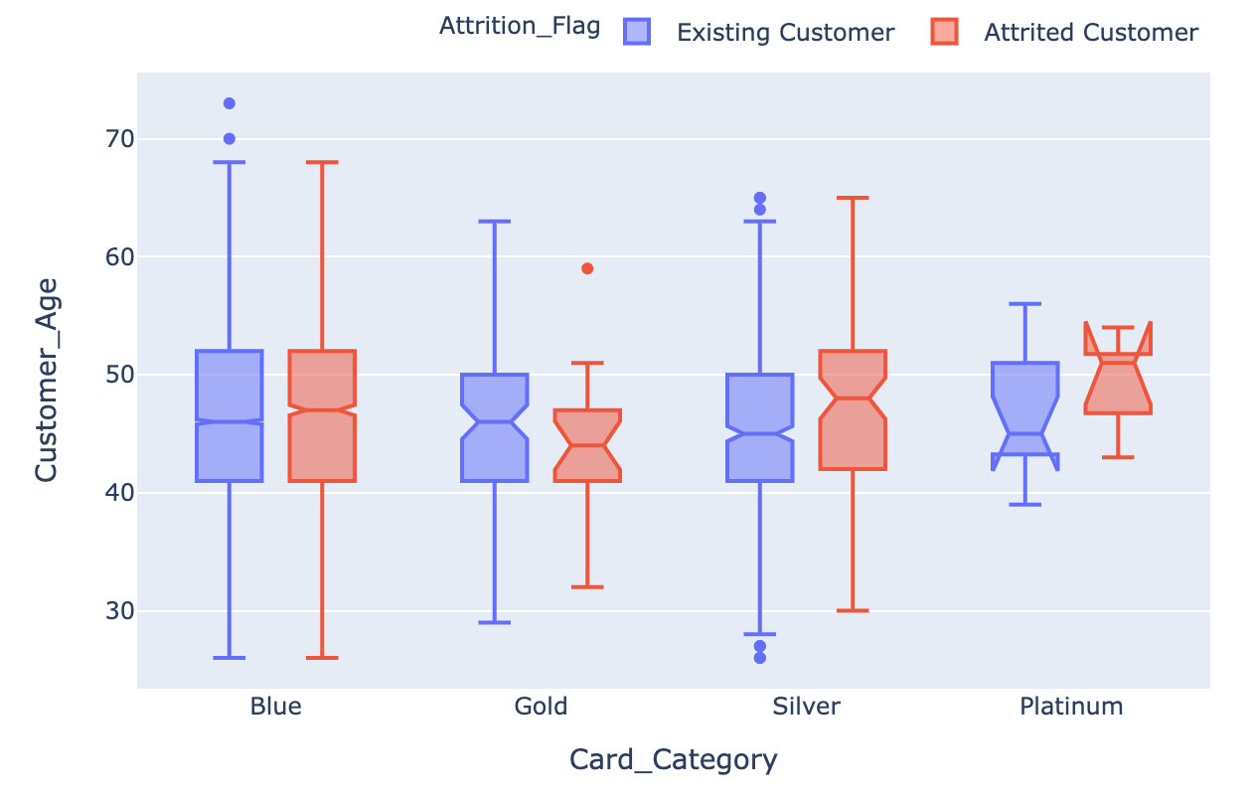
EDA
Credit Limit by Card Category
Customer Age by Card Category and gender
Maximum credit limits for all cards is the same 34,516.
The distribution of customer age is almost identical for all card types, around 45.

Slide 8
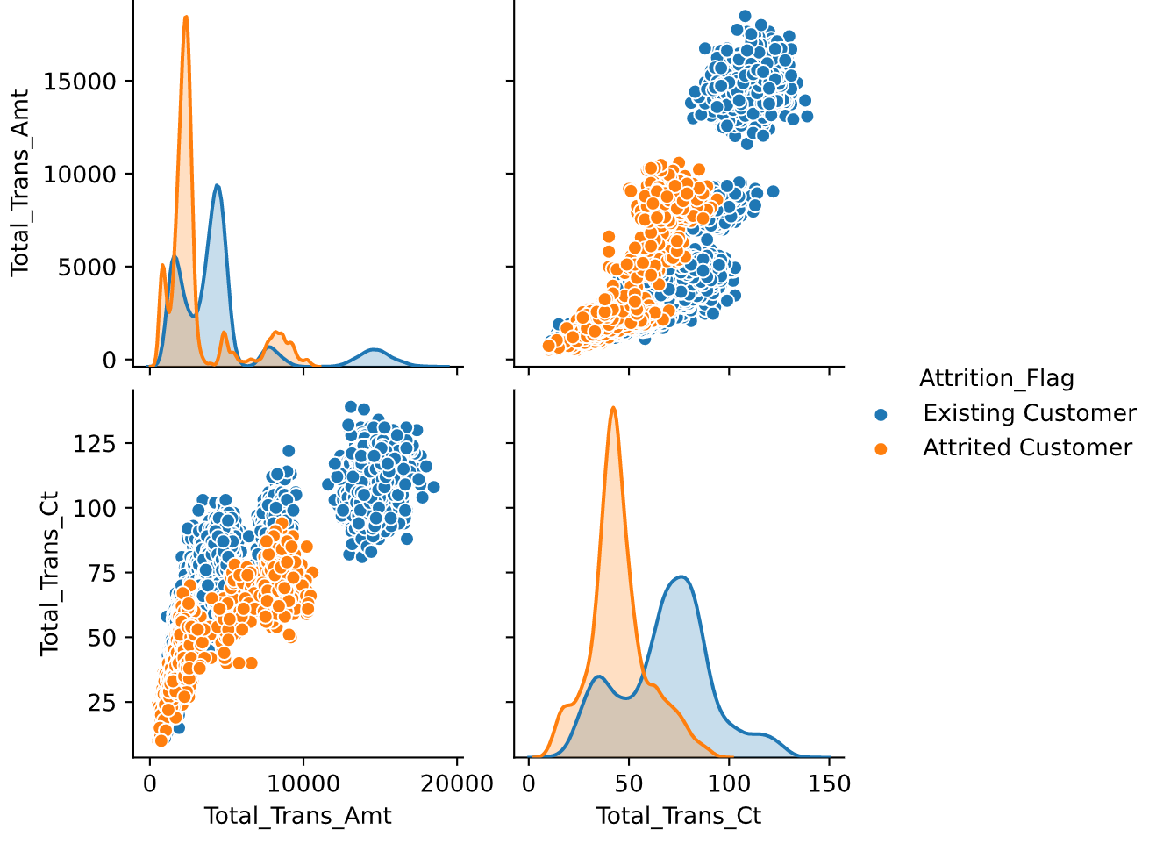
EDA
Existing customer tends to have more transactions than attrited customers.
Also, the existing customer tends to have higher total transaction amount.

Slide 9
Preprocessing
Numeric Columns
Set client id as index
Standardize
Categorical Columns
Create dummy variables
Target: Attrition Flag

Slide 10
Machine Learning - Card Type
Unsupervised Models
Blue Card
Gold Card
Silver Card
Platinum Card

Slide 11

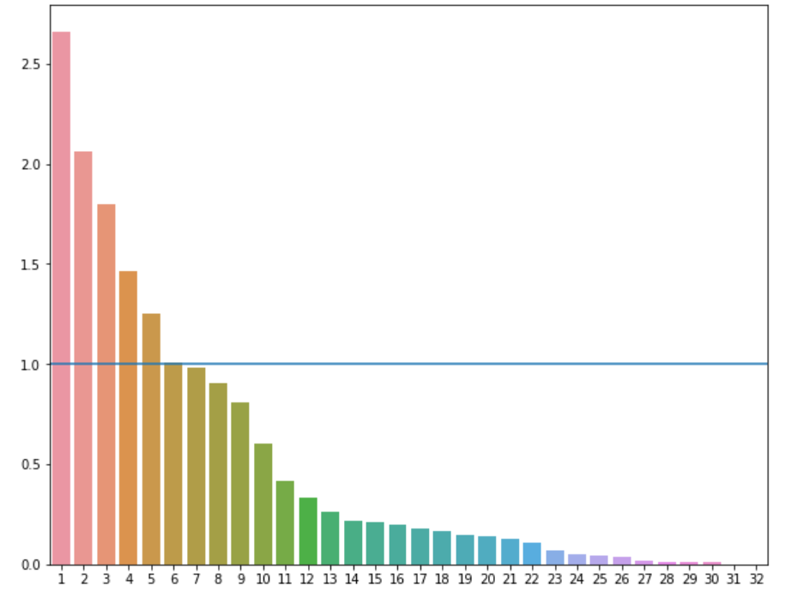
PCA
Cumulative Variance
Reaching 90% Variance with 14 components
Components
Keep 5 most significant components

Slide 12
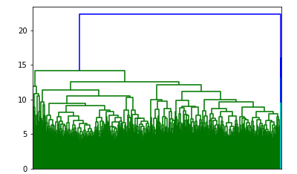
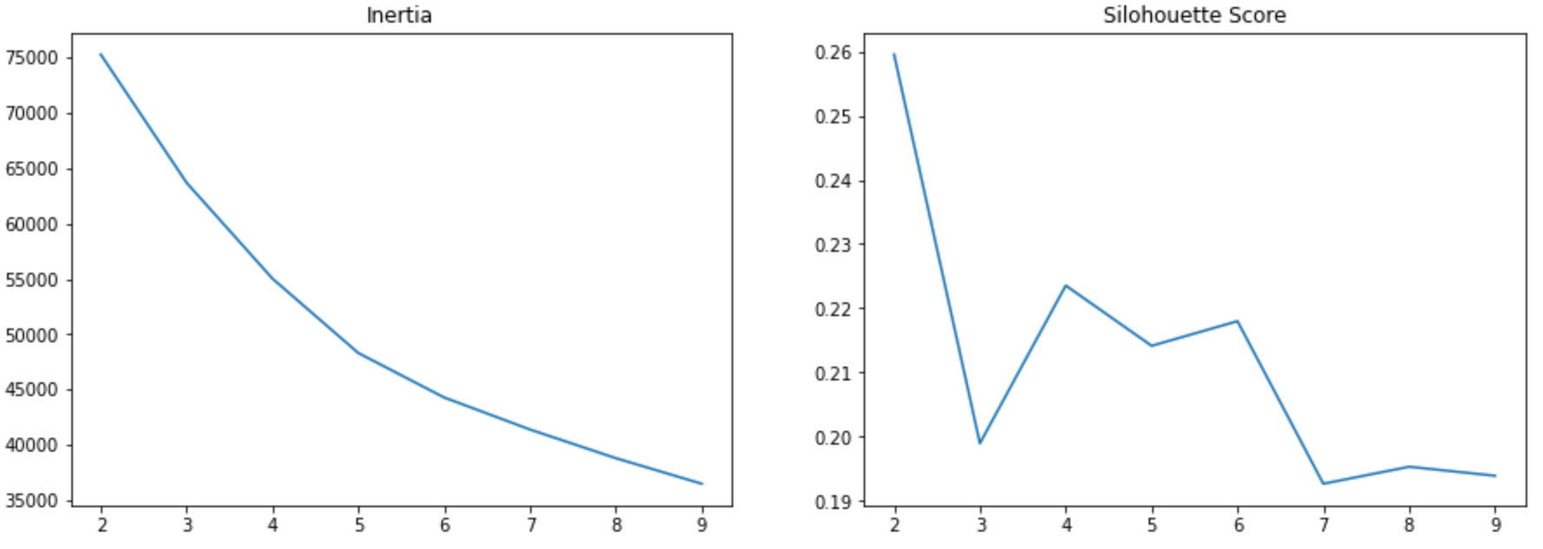
PCA + KMeans
Unsupervised Models
k=4 is a good choice
Low inertia + High silhouette score

Slide 13
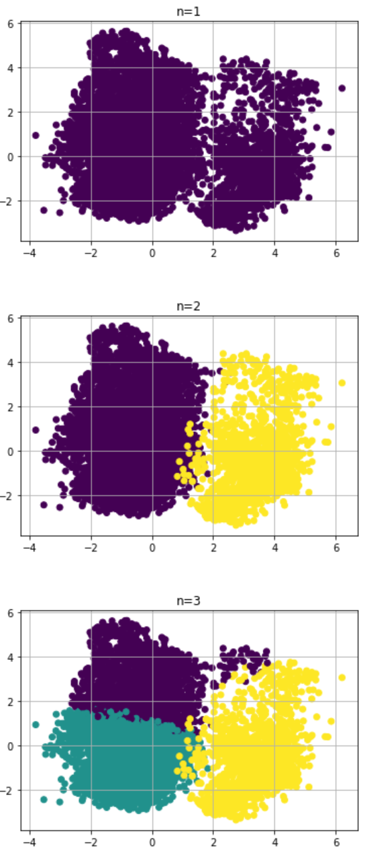
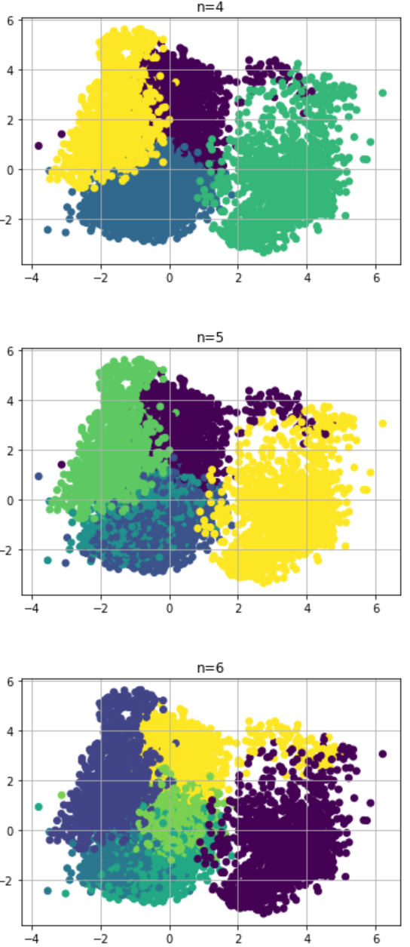
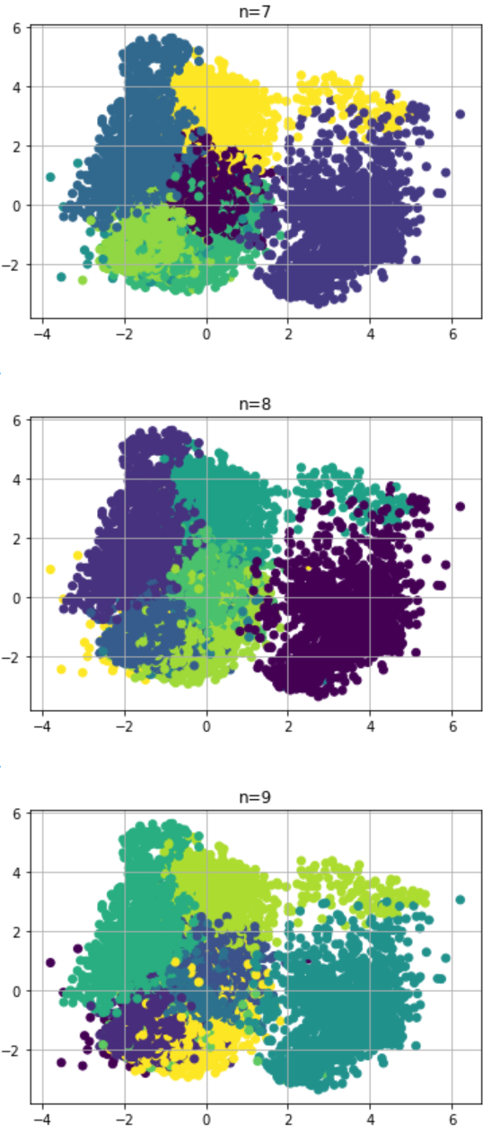
KMeans plot
Unsupervised Model

Slide 14
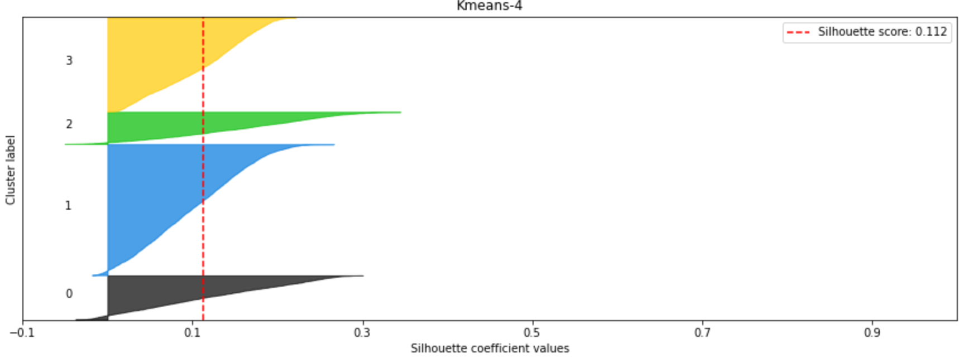
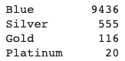
PCA + KMeans
Unsupervised Models
Performed well overall

Slide 15
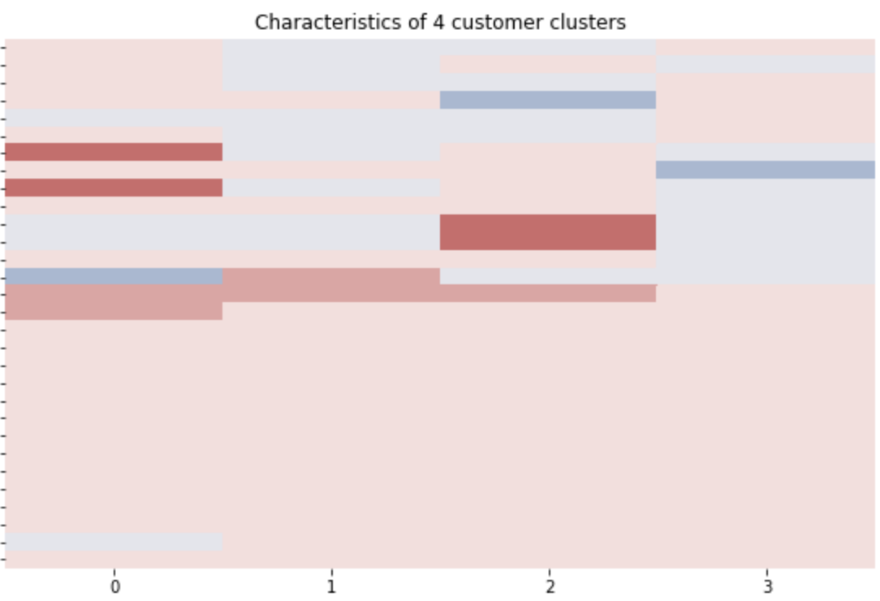
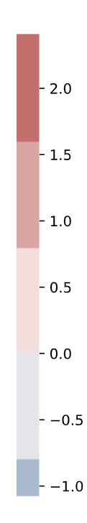
Results
Unsupervised Models
total revol bal
total trans amt
total trans ct
Credit limit
Avg open to buy
Avg utilization ratio

Slide 16
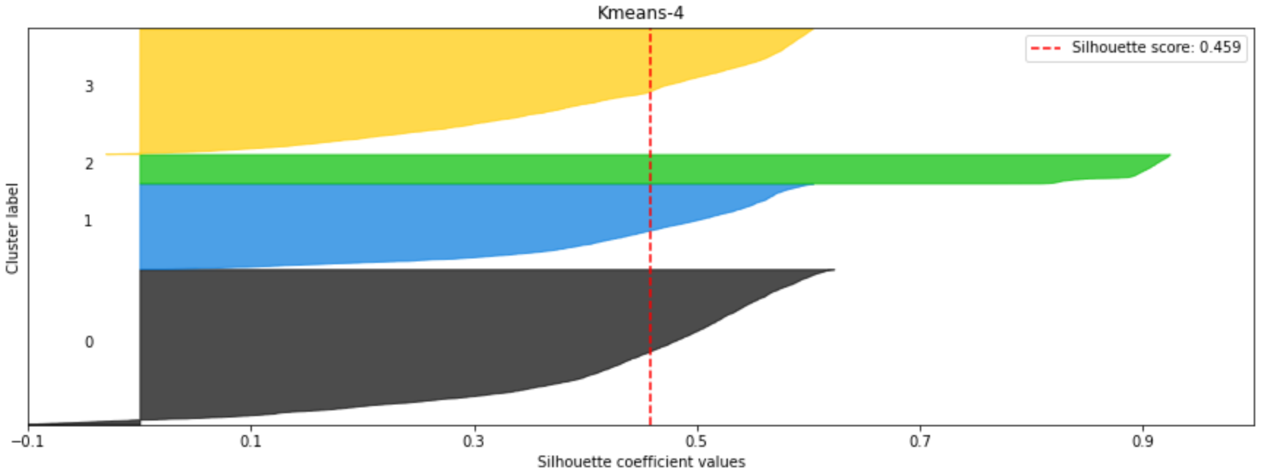
UMAP + KMeans
Unsupervised Models
Fewer miscluster
Higher silhouette score

Slide 17
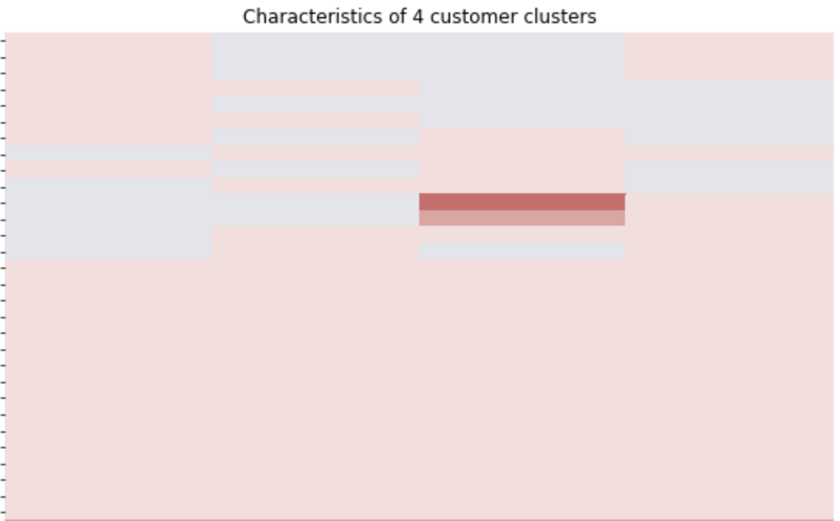
Results
Unsupervised Models
total trans amt
total trans ct
0
1
2
3

Slide 18
Machine Learning - Churn or No Churn
Supervised Model
Attrited customers
Existing customers

Slide 19
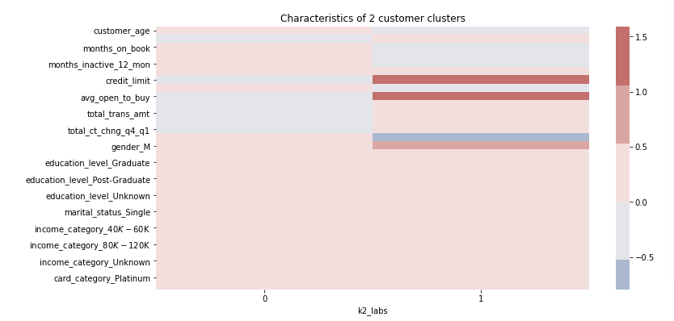
Churn or No Churn
KMeans
Pool performance at k=2
patterns not obvious

Slide 20
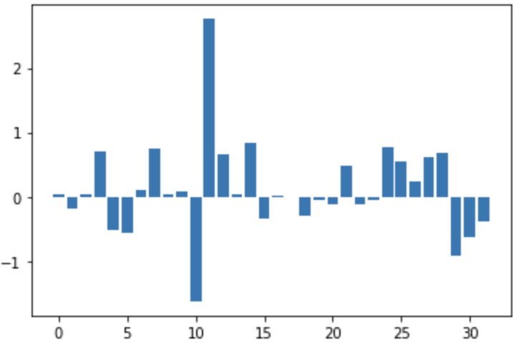
Supervised Models
F1 score
Logistic regression: 0.9
Random Forest: 0.88
Non PCA
total revolving balance
total trans amount
total trans count

Slide 21
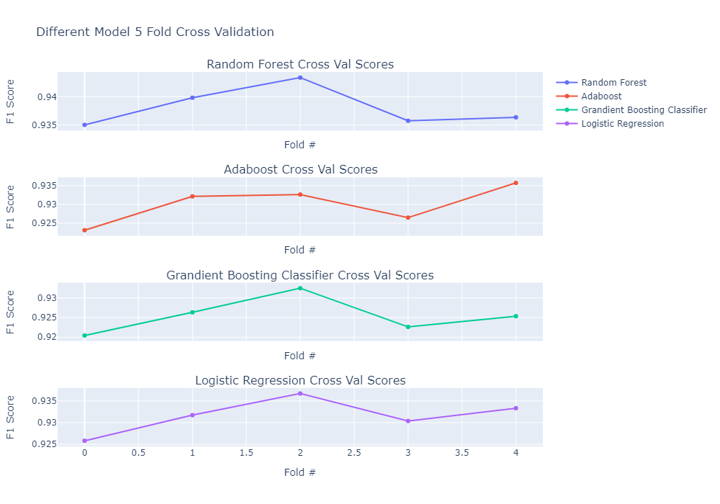
Supervised Models
F1 score
LogisticRegression: 0.93
RandomForest: 0.94
AdaBoost: 0.93
Gradient Boosting: 0.93
After PCA

Slide 22
Conclusion
DBSCAN
Non PCA
Low accuracy according to unbalance variable
Logistic regression: 0.9
Random Forest: 0.88
Unsupervised methods
Supervised methods
Other optimization
K-means
LogisticRegression: 0.93
RandomForest: 0.94
AdaBoost: 0.93
Gradient Boosting: 0.93
TSNE
UMAP
Pool performance
Relatively high silhouette score: 0.45
After PCA
No significant patterns for
k = 2 and k = 4

Slide 23
Conclusion
Strengths
Good silhouette score with Umap.
Weakness
Did not acquire ideal patterns for clustering.
Result of Umap is not really interpretable even with a high silhouette score.
Choice
Pick the result of K-means after PCA for card type clustering.
Card type tend to be a more significant indicator.

Slide 24
Recommendations
01
Identifiable Card Type
03
Cooperation
No enough difference between different card types like Gold and Platinum.
Cooperate with business to launch promotion and policy aiming at different card users.
02
Consider Gender
04
Customer relation
Gender difference account for the attrition condition.
Customers with more relation with the bank tend to stay. Expand business with existing customers.

Slide 25

Q & A

